Slide 1
Transboundary Conservation Areas
Lesson 6: Cooperative Management in Transboundary Conservation
Notes:
Photo Credit: Eastern Tropical Marine Corridor; Archipielago de Revillagigedo: Humpback Whale ©Erick Higuera
*Note that all of the photos in this presentation are of the Eastern Tropical Marine Corridor.
Context and Purpose of Lesson 6
This Lesson seeks to introduce learners to concepts, characteristics and practices of transboundary cooperative management. The purpose is to:
Introduce management concepts and principles
Describe the nature and characteristics of cooperative management in the context of different models of cooperation and governance types
Discuss how cooperative management can be implemented and enhanced
Supplemental Reading
IUCN WCPA Best Practice Guidelines Transboundary Conservation: A systematic and integrated approach (Pgs. 65–69)
IUCN Initiating effective transboundary conservation: a practitioner’s guideline based on the experience from the Dinaric Arc (Pgs. 24–41)
IUCN Guidelines for Protected Areas Legislation (PA Guidelines) (Pgs. 270–271, 280–292)
IUCN Best Practice Guidelines Governance of Protected Areas: From understanding to action (Pgs. 10-12)

Slide 2
Factors of Success
Assess the enabling environment to pursue transboundary conservation
Define the transboundary context and relationships affecting the achievement of the conservation targets and the resulting geographic extent
Identify and involve stakeholders, obtain support of decision makers and ensure political will and buy-in
Agree on common values and joint vision
Determine common transboundary management objectives and develop cooperative agreements
Notes:
Photo Credit: Eastern Tropical Marine Corridor; Archipielago de Revillagigedo: Humpback Whale ©Erick Higuera
Factors of success
Recall the five factors of success in the process of initiating transboundary conservation:
1. Assess the enabling environment to pursue transboundary conservation
2. Define the transboundary context and relationships affecting the achievement of the conservation targets and the resulting geographic extent
3. Identify and involve stakeholders, obtain support of decision makers and ensure political will and buy-in
4. Agree on common values and joint vision
5. Determine common transboundary management objectives and develop cooperative agreements
Lesson 6 provides concepts, approaches and strategies for cooperative management, which is relevant to all five factors. In particular, factors 4 and 5 relate to cooperative management, as management requires agreement on common values and joint vision as well as common transboundary management objectives and frameworks, which can take the form of cooperative agreements. The concepts introduced in this lesson lay the groundwork for skills necessary for these factors, which will be practiced in Lesson 7.

Slide 3
Lesson Overview & Goals
Cooperative Management in Transboundary Conservation
Management definition and concepts
Defining cooperative management in a transboundary context
Characteristics of transboundary cooperative management
Ways to enhance transboundary cooperative management
Notes:
Photo Credit: Eastern Tropical Marine Corridor; Archipielago de Revillagigedo: Humpback Whale ©Erick Higuera
Content overview
This lesson will address:
Management definition and concepts including clarification of the difference between management and governance
Defining cooperative management in a transboundary context as a discussion of what cooperative management is and how it relates to the models of cooperation introduced in Lesson 1
Characteristics of transboundary cooperative management including key principles, frameworks, challenges and benefits of cooperative management
Notes and suggestions for enhancing transboundary cooperative management

Slide 4
What is Cooperative Management?
What is management? What is cooperative management?
…
Notes:
Photo Credit: Eastern Tropical Marine Corridor; Archipielago de Revillagigedo: Whale Shark ©Erick Higuera
Discussion
Use this slide to start a discussion. Ask learners:
What is management? How is it different from governance?
What is cooperative management? How is it different from other forms of management?
Pause the slideshow and take notes on the slide itself to record learner’s responses. Duplicate the slide if you need more space. Afterwards, responses can be shared with learners.

Slide 5

What is Management?
Governance is about process: Who takes decisions
Management is about substance: How decisions are implemented
Who brings people together?
Who decides what the objectives are?
Who decides how differences are resolved?
How are decisions taken?
Who ensures the resources and conditions for effective implementation?
Who holds the power and responsibility?
Who is held accountable?
What is done in pursuit of given objectives?
What are the means and actions to achieve objectives?
How is effectiveness generated and ensured?
Notes:
What is management?
Lesson 4 covered governance.
Recall from Lesson 4 that governance and management are often confused.
Governance is about process: Who takes decisions?
Who brings together people to determine what ought to happen?
Who decides what the objectives are and how differences are reconciled?
How are decisions taken?
Who ensure the resources and conditions for effective implementation?
Who holds power, authority and responsibility?
Who is held accountable?
Management is about substance: How decisions are implemented
What is done in pursuit of given objectives?
What are the means and actions to achieve objectives?
How is effectiveness generated and ensured?
Another way to describe this: governance is about who takes decisions, and management relates to the implementation of decisions taken.
Discuss some examples of management and governance:
The board (governance authority) takes a decision on strategic objectives for the protected area, and the Management Authority implements it.
What are some other examples?

Slide 6

What is Management?
Management Authority
Prepares and implements the management plan
Reports on the state of the conservation area
Deals with emergencies
Manages the financial resources
Management Plan
Conservation objectives and threats
Actions and measures to be taken
Prohibited and permitted activities
Zones and boundaries
Sustainability and accountability
Notes:
Photo Credit: Archipielago de Revillagigedo: Giant manta ray ©Valeria Mas Gomez
What is management?
In the protected area context, management often involves a management authority and management plan.
The management authority
Is responsible for preparing and implementing the management plan
Reports on the state of the conservation area
Deals with emergencies
Manages the financial resources
The management plan
States conservation objectives and threats
Includes actions and measures to be taken for management to guide the management authority
Informs decisions about prohibited and permitted activities
Identifies boundaries and zones within protected area
Includes sustainability component, both in terms of conservation and finances/administration
Promotes accountability by providing indicators to monitor and measure progress towards achievement of management objectives

Slide 7
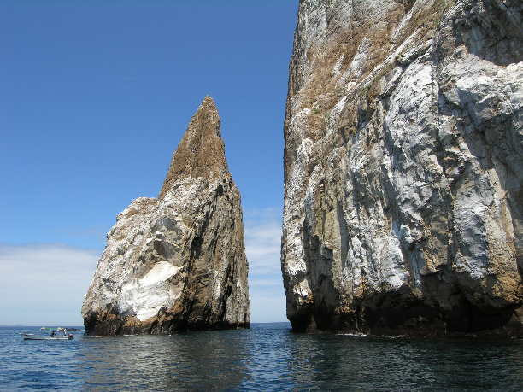
What is Cooperative Management?
Cooperative management is taking action together to implement decisions and pulling together the available means to reach the agreed aim/results.
In a transboundary context cooperative management involves international cooperation
Cooperative Management Requires:
Shared understanding of issues
Common vision
Agreed objectives
Means of implementation
Incorporation of different sectors
Participation of relevant stakeholders
Notes:
Photo Credit: Galápagos Islands (Ecuador) ©UNESCO / Francesco Bandarin
What is cooperative management?
Cooperative management is taking action together to implement decisions and pulling together the available means to reach the agreed aim/results.
In a transboundary context, cooperative management involves stakeholders from two or more countries with a common interest in the conservation of a shared ecosystem or species, cooperating formally or informally.
Cooperative management requires:
A shared understanding of issues
A common vision
Agreed objectives
A means to deliver transboundary conservation
Cooperative management often includes cooperation between different sectors, levels of government and stakeholder groups.

Slide 8
Models of Cooperation and Cooperative Management
Models of Cooperation
Communication or Information sharing
Consultation
Coordinated action
Joint implementation of decisions
Cooperative management
Notes:
Photo Credit: Archipielago de Revillagigedo: School of Cottonmouth Jack ©Robert Wilpernig
Models of coopeation and cooperative management
Management mechanisms relate to the model of cooperation, discussed in Lesson 2.
All transboundary conservation implies cooperation between parties across the international boundary. Without cooperation between parties from two or more countries there can be no transboundary conservation. The form of cooperation may vary from sharing information, communication, consultation and coordinated action to the joint implementation of decisions.
However, only coordinated action and joint implementation of decisions, the last two models of cooperation, are considered as forms of cooperative management. In these two models, there are jointly coordinated and/or implemented actions.
It is important to recognize that in practice, cooperative management can take many forms.

Slide 9
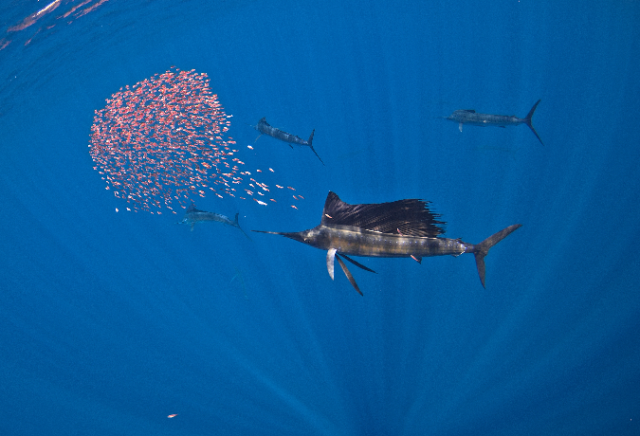
Principles of Cooperative Management
Cooperative management is guided by key principles and approaches agreed on by the relevant stakeholders
Key Principles
Ecosystem approach
Precautionary approach
Sustainability
Adaptive management
Good governance
Notes:
Photo Credit: Archipielago de Revillagigedo: Indo-Pacific Sailfish and Red Snapper juvenile ©Erick Higuera
Principles of cooperative management
Characteristics of transboundary management:
Cooperative management is based on management principles which should be agreed by the stakeholders.
Certain principles have been widely endorsed by the conservation community for the effective management of protected areas:
Ecosystem approach: recognizing the interconnectedness of ecosystems and the necessity of integrated and cross-sectoral management that recognizes connectivity
Precautionary approach: lack of scientific certainty should not be used as a reason for postponing cost effective measures to mitigate threats of serious or irreversible damage
Sustainability: commitment to development that provides needs of the present generation without compromising the ability of future generations to meet their own needs
Adaptive management: management that ensures flexibility and iterative development to incorporate new information and reflect changing circumstances
Good governance: principles of transparency, accountability, participation and access to information in decision-making relating to the TBCA

Slide 10
Strategies for Cooperative Management
Strategic level
Negotiating a joint vision
Negotiating common management objectives
Developing a joint management plan
usually longer-term, to be revisited every 5-10 years
Operative level
Developing an action plan for implementation of common management objectives
usually short-term, to be revisited annually
Pursuing strategies can be time consuming, but the process is essential to enable and sustain efficient cooperative management in a TBCA
Notes:
Strategies for cooperative management
Cooperative management is based on frameworks that provide guiding principles and goals as well as processes for management planning and implementation. Developing cooperative management frameworks requires activities at the strategic and operative levels.
Strategies for the establishment and enhancement of cooperative management:
Negotiating a joint vision (elaborated in Lesson 7)
Negotiating common management objectives (elaborated in Lesson 7)
Joint management plan (usually long-term, to be revisited every 5-10 years)
Developing an action plan for implementation of common management objectives (usually short-term, to be revisited annually)
The first three result in more strategic, higher-level documents, while the last one is at operative (implementation) level.
Pursuing these strategies can take a lot of time, but they are essential to sustain effective and efficient cooperation in transboundary conservation.

Slide 11
Governance Models and Cooperative Management Frameworks
Cooperative management frameworks relate to the governance model
Formal Governance
Informal Governance
General framework
Legally binding agreement or treaty
Non-binding agreement or MOU
Regional cooperative framework
Protocol or contingency plan
Framework for Management
Legally adopted joint strategy or action plan
Protocol or appendix to agreement
General framework
Informal agreement
Practical cooperation
Traditional arrangement
Informal written communication
Framework for Management
Informally agreed management framework
Workshop outcome document
Notes:
Governance models and cooperative management frameworks
Management frameworks can be more or less formal depending on the governance model.
General frameworks for formal governance can take the form of:
Legally binding agreement or treaty
Non-binding agreement or MOU
Regional cooperative framework
Protocol or contingency plan
For informal governance, general frameworks can take the form of:
Informal agreement between protected area managers
Practical cooperation
Traditional arrangement
Informal written communication
Within the general framework, there should be a specific framework for management for the Transboundary Conservation Area (TBCA)
For formal governance, this can be a legally adopted joint strategy or action plan, which could be a protocol or appendix to an agreement
For informal governance, the framework for management planning is an informally agreed mode of working, which could be a workshop outcome document
It is important to recognize that in reality, joint management plans are rare. It is more common to see management cooperation in practice based on strategic activities. However, even in these cases it is helpful to have a management framework that provides general guidance for harmonizing management activities on all sides of the border.

Slide 12

Challenges in Cooperative Management
Key Challenges
Inaccessible terrain and/or remoteness
Insufficient communication networks
Language differences
Conflicting resource management policies
Disparate resource availability
Notes:
Photo Credit: Archipielago de Revillagigedo: Leather Bass ©UNESCO / Richard Henry Salas
Challenges in cooperative management
Cooperative management can pose many challenges. Some examples include:
Inaccessible terrain and/or remoteness. It can be difficult to access certain areas along the border, or physically cross the border where the TBCA exists.
Insufficient communication networks. Communication can be inadequate due to networks that are separate or independent, or that do not have sufficient coverage or reach.
Language differences. Communication can be further impeded when actors on different sides of the border do not speak a common language.
Conflicting resource management policies. Differences in policy as well as legal and institutional frameworks can impede cooperation.
Disparate resource availability. Often one side has more resources or different resources than the other. This can sometimes be turned to advantage, but other times can impede harmonization of management and enforcement activities.

Slide 13
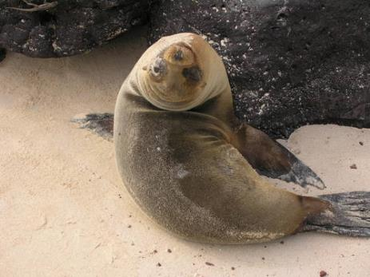
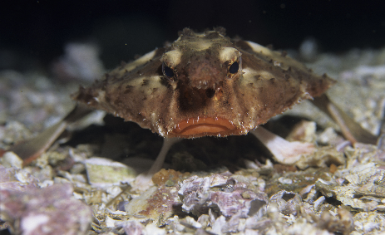
Importance of Cooperative Management
Cooperative management in TBCAs can enable and enhance:
Cooperation between different sectors
Cooperation within the same sector
Realization of different types of benefits for
  nature and conservation
  local communities
  local, regional and national economy
  political relations and peace building
  harmonization of policy
Mutual trust and relationships
Notes:
Photo Credit: Eastern Tropical Marine Corridor: Galapagos Islands ©UNESCO / Francesco Bandarin (top); Malpelo Fauna and Flora Sanctuary, Bat Fish – Ogcocephalus porrectus ©UNESCO / Yves Lefèvre (bottom)
Importance of cooperative management
Cooperative management serves an important purpose in transboundary conservation. Cooperative management can enable and enhance:
Cooperation between different sectors, such as government agencies and Indigenous Peoples
Cooperation within the same sector, such as several stakeholder groups of local communities
Realization of different types of benefits for:
nature and conservation
local communities
local, regional and national economy
political relations and peace building
and harmonization of policy.
Mutual trust and relationships
These benefits of cooperative management can outweigh the costs. More detail on benefits of transboundary cooperation were provided in Lesson 1.
Examples of benefits of cooperative management can be found in the Best Practice Guidelines, which may be distributed as handouts:
Box 6, p. 24 describes an example of cooperative management for saving the endangered Cross River Gorilla in Nigeria and Cameroon
Box 16, p. 67 elaborates the initiation of cooperative management in the Emerald Triangle between Cambodia, Laos and Thailand to combat poaching and human encroachment

Slide 14

Enabling Conditions for Cooperative Management
Key enabling conditions to establish cooperative management in a transboundary context
Clear reason for cooperation
Benefits outweigh the costs
Mandates from decision-making bodies are secured
Key stakeholders are identified
Leadership has been agreed
Notes:
Photo Credit: Eastern Tropical Marine Corridor: Cocos Island National Park ©UNESCO / Marjaana Kokkonen
Enabling conditions for cooperative management
There are certain key enabling conditions for establishing cooperative management arrangements.
Clear reason for cooperation. Pursuing strategies for establishment of cooperative management is critical if cooperation is to survive over the long term. However, Parties need to ensure that they think carefully about why they intend to cooperate.
Parties are sure that the benefits of transboundary conservation outweigh the transaction costs. As discussed in Lesson 1, transboundary conservation can provide significant benefits as well as costs. Many of these costs relate to cooperative management. For cooperative management to be successful, it is important for all parties to recognize that the benefits outweigh the costs. This can be supported by feasibility studies, described in Lesson 3, which can be used to show that the benefits of a TBCA outweigh the costs.
Mandates from decision-making bodies are secured. As introduced in Lesson 4, management depends on clear and adequate governance frameworks. Management bodies need clear authority determined by governance processes. Mandates for management can be based on frameworks that are more or less formal, as discussed later in this presentation.
Key stakeholders are identified and leadership has been agreed. Lesson 5 provided information on determining leadership and involving relevant stakeholders. These factors are essential for effective cooperative management.

Slide 15
Cooperative Management in Practice
Potential practical measures for cooperative management in
transboundary conservation
Day-to-day management
Monitoring of species
Ecosystem restoration
Staff training and exchange visits
Research and sharing of information
Avoiding human-wildlife conflict
Supporting social connections
Joint fundraising and project implementation
Common tourism related activities
Harmonisation of policy and development of agreements
Developing a communication strategy
Public relations and media work
Notes:
Cooperative management in practice
In practice, cooperative management can take many forms. Potential practical measures for cooperative managment in transboundary conservation include cooperation in:
Day-to-day management: e.g. sharing of heavy equipment, organization of joint patrols to combat poaching and illegal wildlife trade, cooperation in wildfire management
Monitoring of species
Ecosystem restoration
Staff training and exchange visits
Research and sharing of information
Avoiding human-wildlife conflict – one should be careful here as this is a sensitive issue
Supporting social connections: e.g. trade of local producs across borders, sport events, local festivals and celebrations
Joint fundraising and project implementation
Tourism related activities: e.g. development of joint tourism products (joint marketing, e.g. common map), promotion of local cultural heritage, common identity (e.g. logo, website), route signage, cooperation in tourism planning, provision of simplified border crossing procedures and visa requirements, one-fee-only system, common code of conduct for visitors, simplified licensing and fees for guides crossing borders with tourists, engagement of local entrepreneurs and involvement of local people in providing services for tourists
Harmonisation of policy and development of agreements
Developing a communication strategy
Public relations and media work. Communication efforts should be harmonized among all parties.

Slide 16
Discussion
What are your experiences with protected or conserved area management?
What is different in management of TBCAs?
  …
Notes:
Photo Credit: Eastern Tropical Marine Corridor; Archipielago de Revillagigedo: Whale Shark ©Erick Higuera
Discussion
Use this slide to start a discussion.
Ask learners about their experience with management.
What is your experience with management in protected areas?
What is different in management of TBCAs?
Pause the slideshow and take notes on the slide itself to record learner’s responses. Duplicate the slide if you need more space. Afterwards, responses can be shared with learners.
Questions and answers
Following the discussion, ask learners if they have any questions on the lesson, or on anything the other learners have said.

Slide 17
Transboundary Conservation Areas
End of Lesson 6
Notes:
Photo Credit: Eastern Tropical Marine Corridor; Archipielago de Revillagigedo: Humpback Whale ©Erick Higuera

